Slide 1
COVIDENCE Covidence.org
Accelerate your systematic review
Marian Showell
Information Specialist
Cochrane Gynaecology & Fertility Group
June 2021
Photo credit Cochrane Community

Slide 2
Content
What is Covidence?
To start a new review
Import references
Title and abstract screening
Full text screening
Data extraction
Assessment of quality (RoB)
Exporting
Photo credit Cochrane Community

Slide 3
What is Covidence?
Cloud based review management system; covidence.org
Real time collaboration, multiple authors
Estimated to save 35% of time, or 71 hours per review
Non-profit developed by reviewers for reviewers
Free for Cochrane reviewers
Photo credit Austin Health: auction.org.au

Slide 4
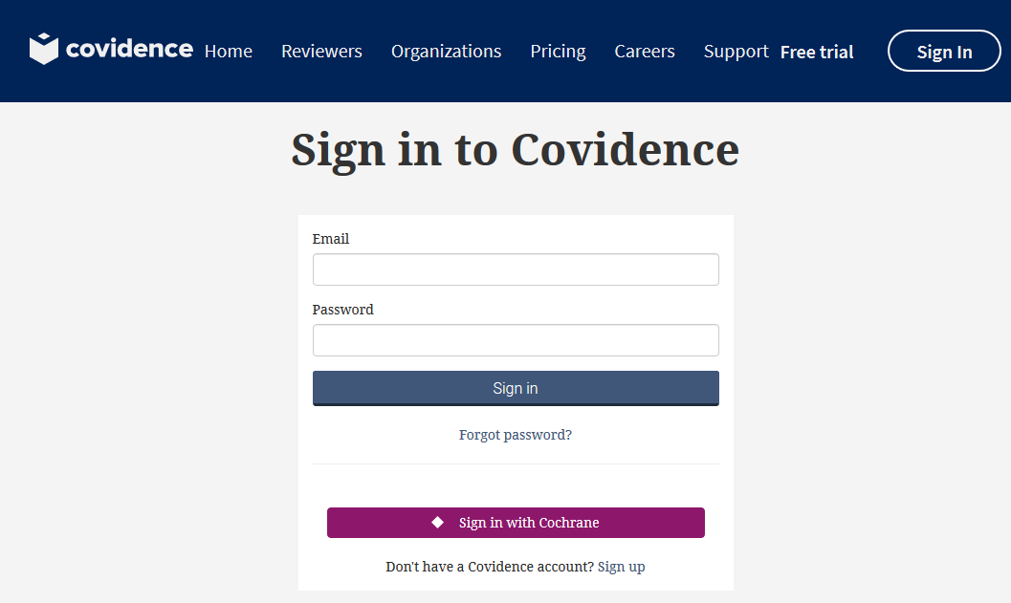
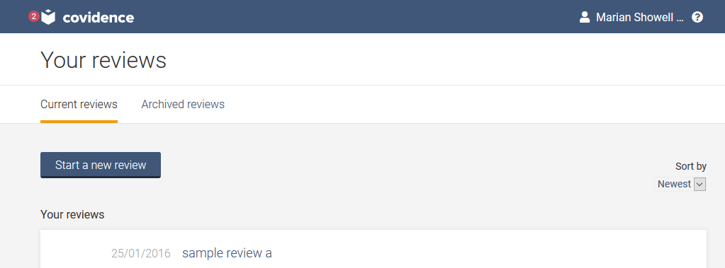
Sign in with Cochrane

Slide 5
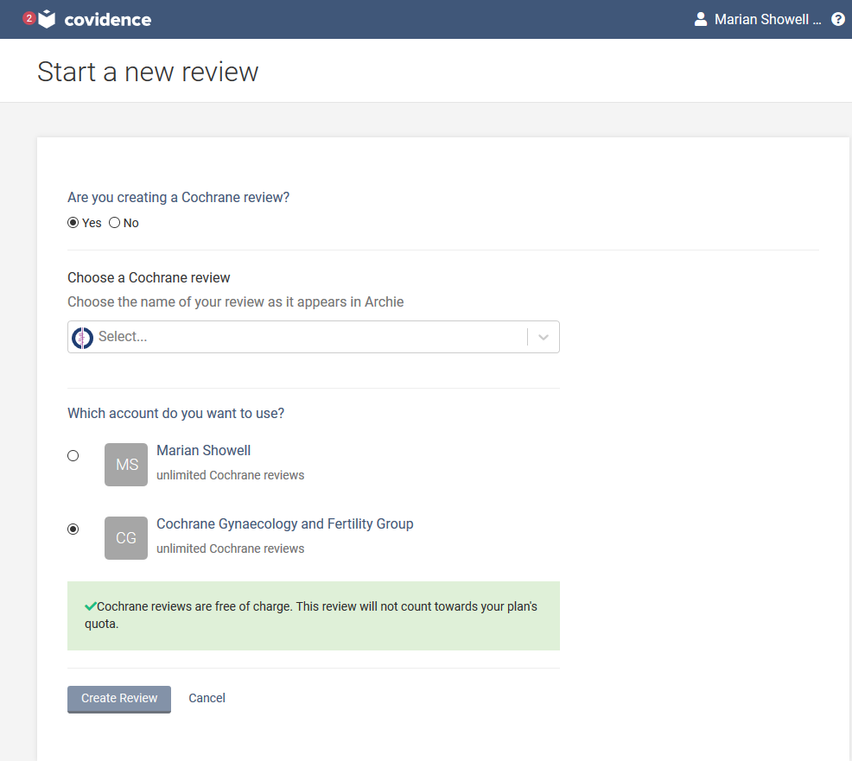
Notes:
Sign in with Cochrane then start typing in the title of your review it will appear and create review then invite other reviewers

Slide 6
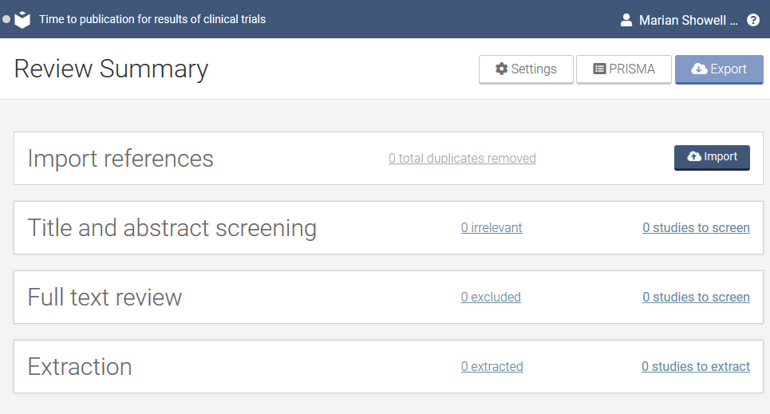
Dashboard
Demo review
Help; FAQs, email
Notes:
Before you start go to settings to se the parameters for the review

Slide 7
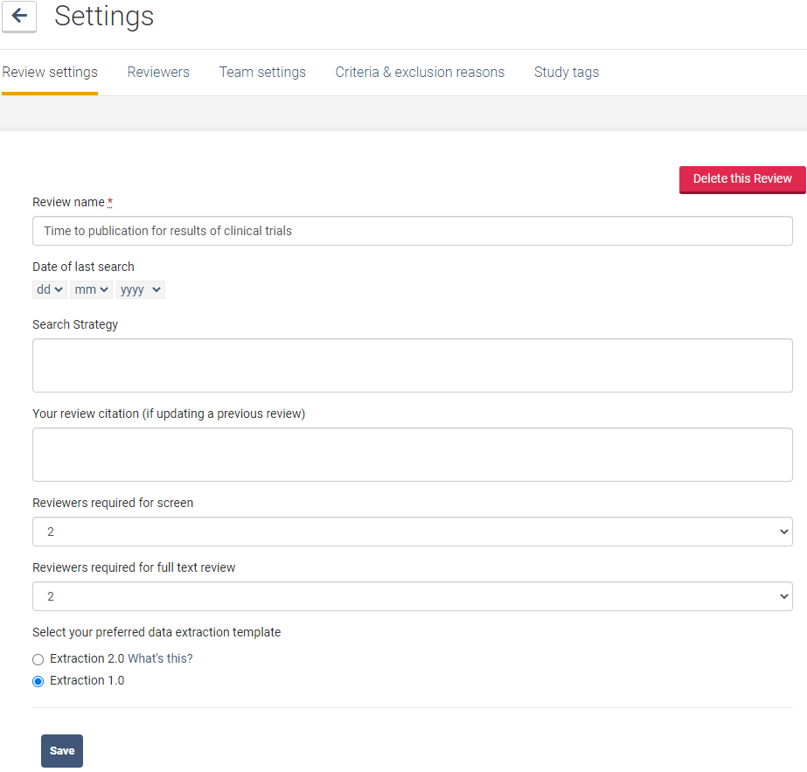
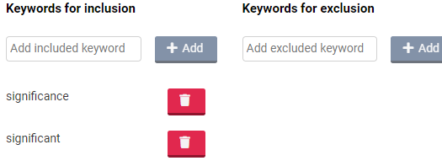
Highlighting the keywords
Notes:
Make sure extraction 1.0 is ticked as this extraction is recommended for Cochrane reviews as the structure aligns better with Cochrane reviews Covidence team are still working n 2.0
Team settings show who has done what and you can build rules around who does what and who resolves conflicts
Set inclusion/exclusion criteria here which will then be available in screening and full text also at the bottom of the page it will allow you to add highlights to prescribed words i.e. random will appear in the title and abstract while you are screening and in full text

Slide 8
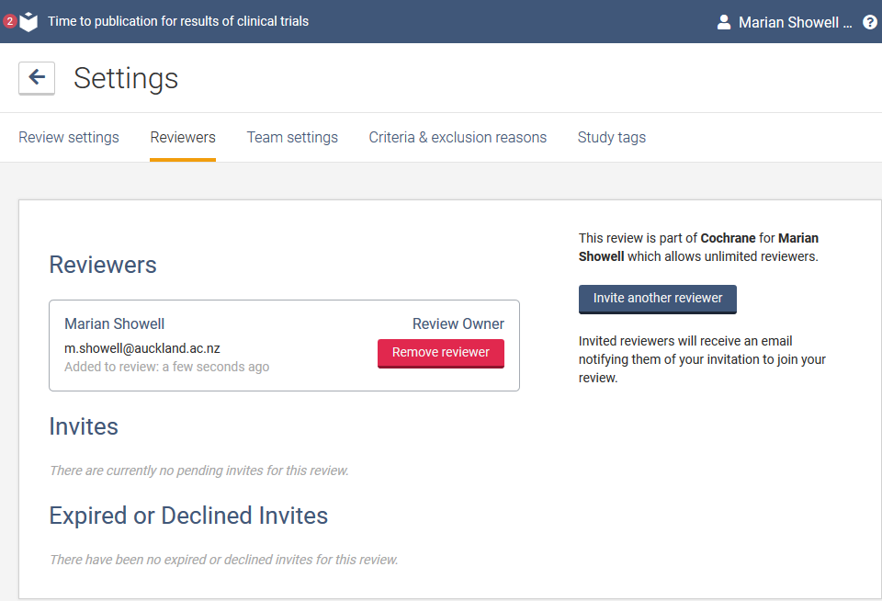
Notes:
Invite other reviewers

Slide 9
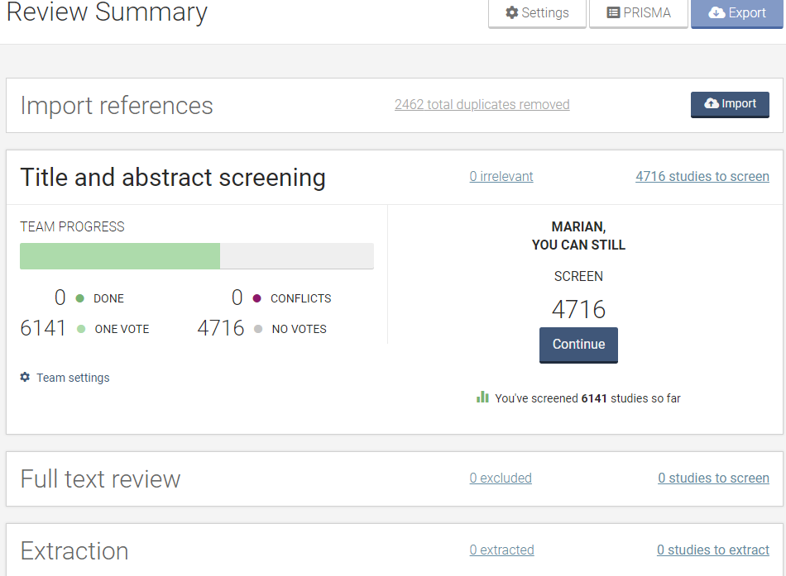
Notes:
Dashboard show import history deduplication and Resolve conflicts will tell you who voted what and you choose the final decision include/exclude

Slide 10
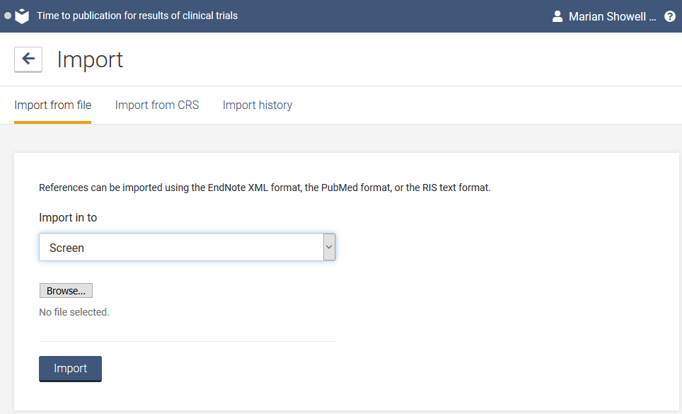
Notes:
Demo review to play with under your name Covidence works seamlessly with reference managers like EndNote, Zotero, Refworks, Mendeley or any tool that support RIS, CSV or PubMedXML formats.

Slide 11
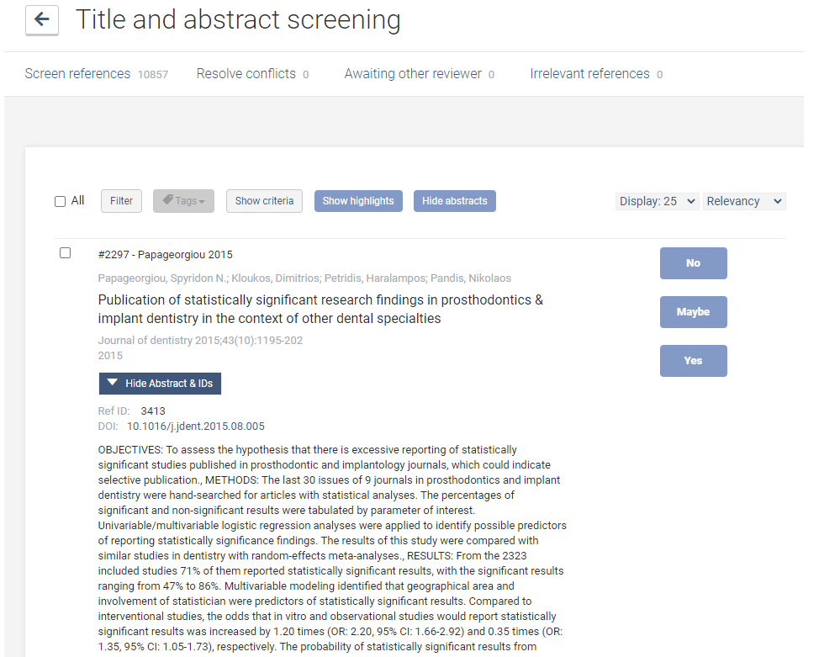
Screening Title and Abstract

Slide 12
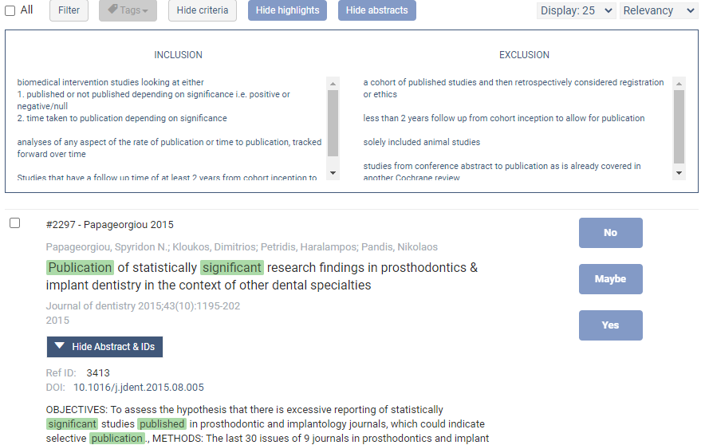
Screening Title and Abstract
Notes:
Filter by a key word i.e., random and then can search for it is a choice of title/abstract, authors or everything

Slide 13
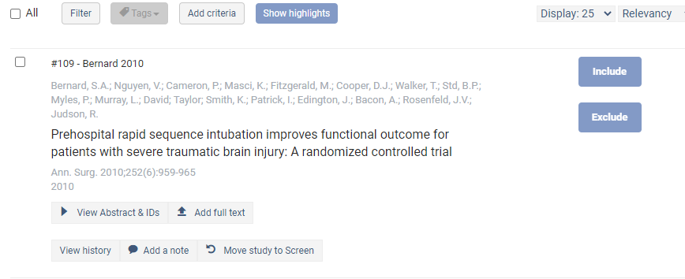
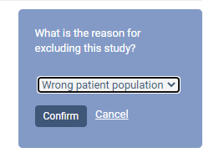
Full Text Screening
Notes:
Full text screening
Transfer PDFs stored in your reference manager to Covidence in a few clicks. Can do a bulk upload
Decide quickly on studies in full text. Capture reasons for exclusion and any notes so you can resolve any disagreements quickly, with a click of a button –include exclude

Slide 14
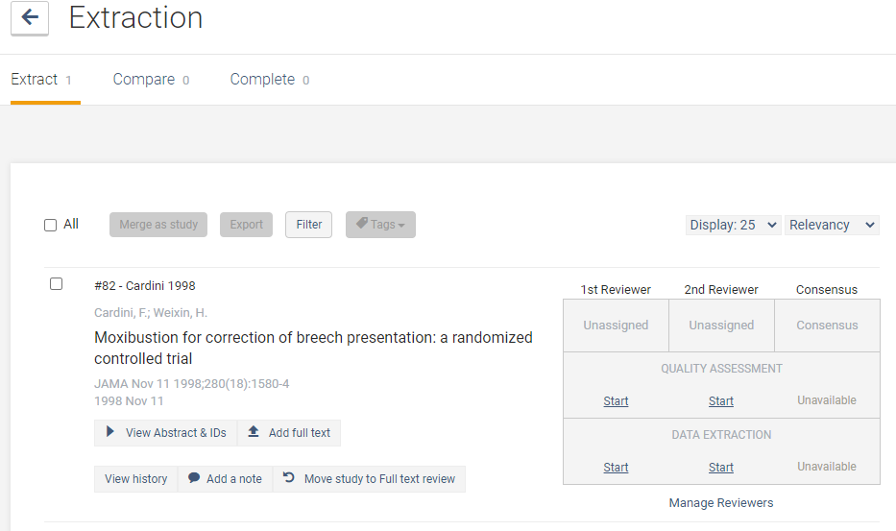
Notes:
Click on start if set up in settings your name will be in the box assigned Automatically populate your risk of bias tables by highlighting and commenting on text directly in your PDF. No more cut and paste

Slide 15
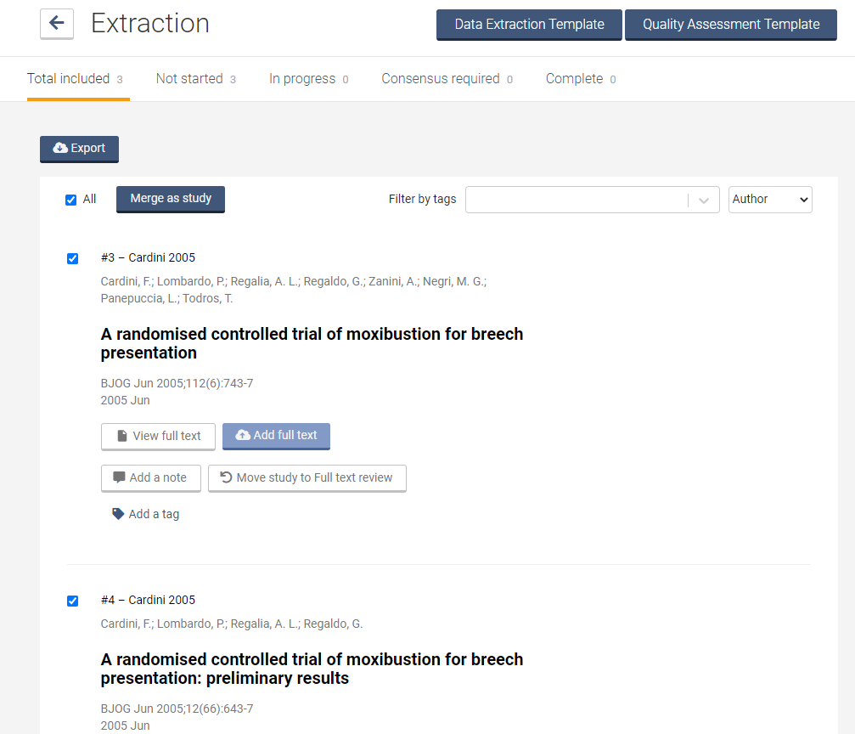
Merging References of Same Trial

Slide 16
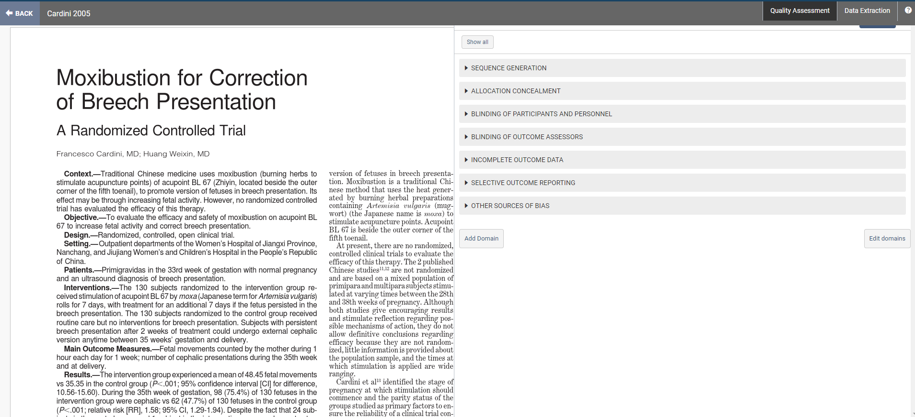
Assessment on the Quality of Studies (RoB)
Notes:
Assess RoB
Can use the default template or Create customised extraction templates to suit you, then export a single, machine-readable file that easily integrates into all the common statistics packages

Slide 17
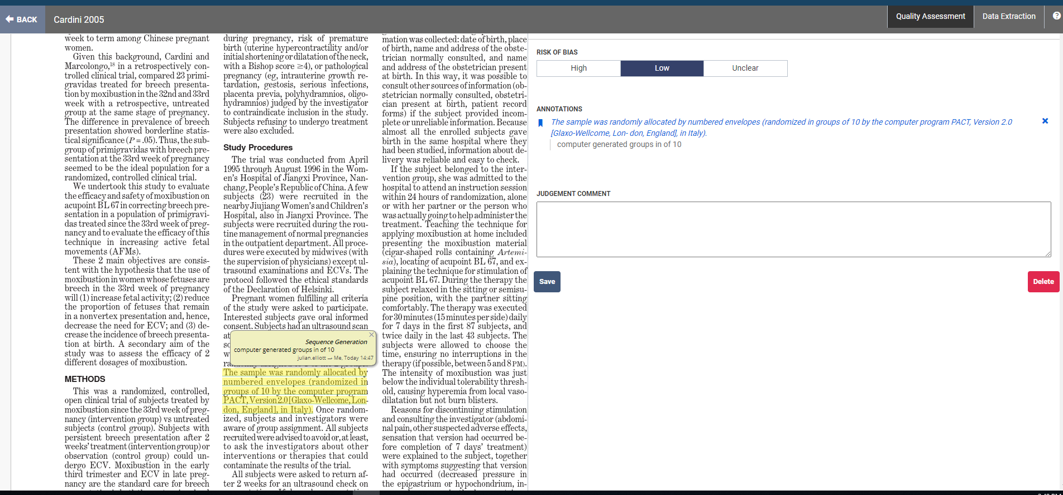
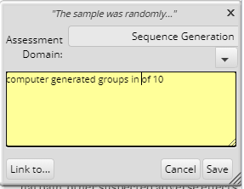

Slide 18
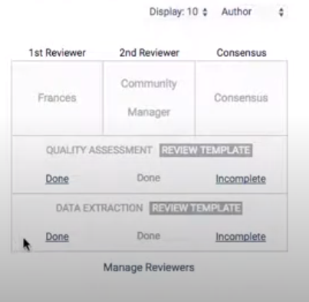
Consensus
Notes:
Consensus of quality assessment and same sort of thing for data extraction

Slide 19
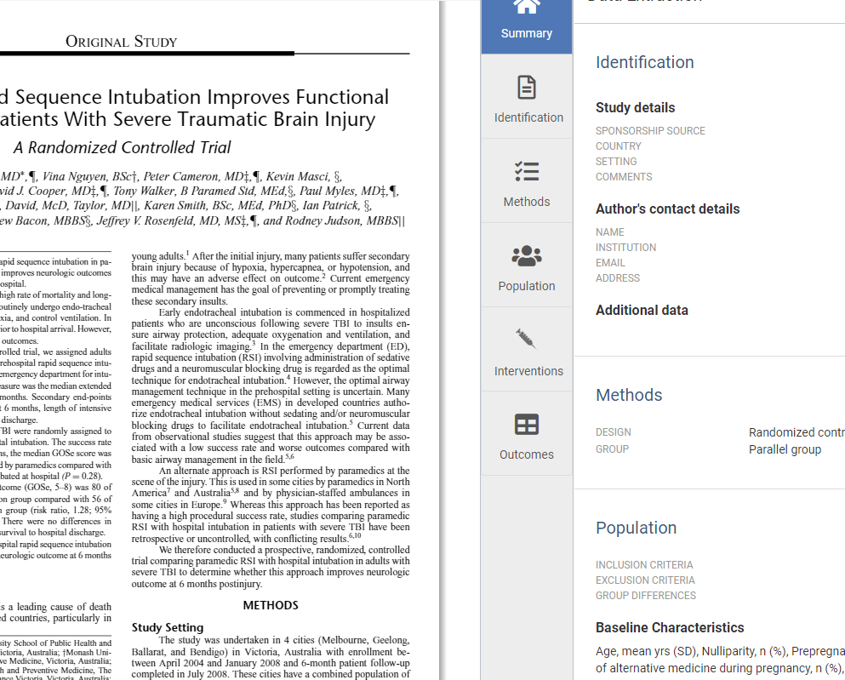
Data Extraction
Study characteristics
Data extraction
Notes:
Advice is to work on the outcomes before the intervention. Once reached consensus can export the references, tables and data

Slide 20
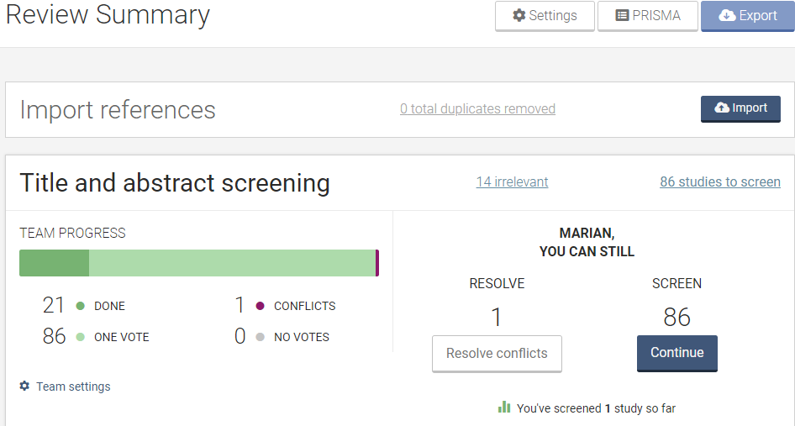
Exporting
Notes:
When ready to export return to the dashboard and select export studies/data in export tab and/or PRISMA for numbers of studies for the PRISMA diagram in revman

Slide 21
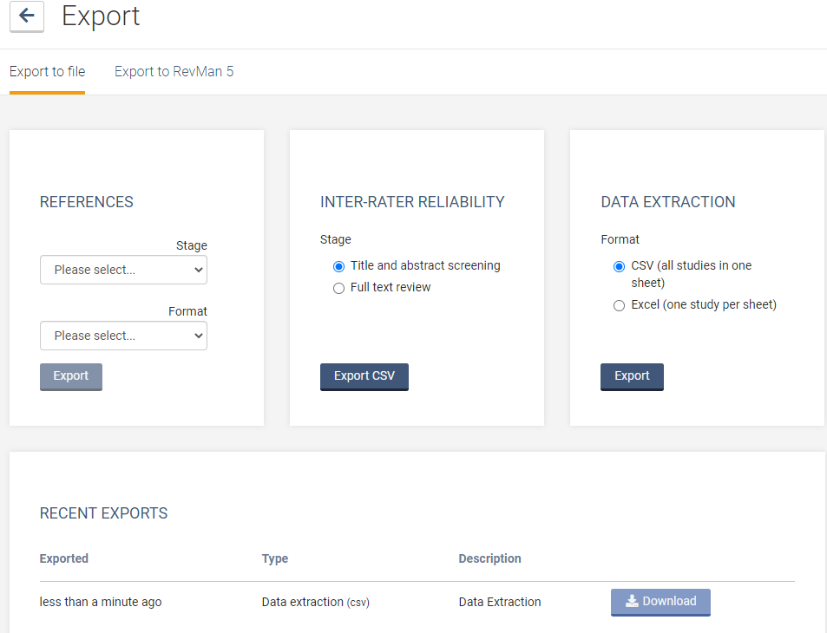
Only for NEW systematic reviews
For review UPDATES
Notes:
Stages include screening full text included excluded irrelevant
Format includes CRS CSV, ENDNOTE, Mendeley, Refworks, Zotero
Export the data into REVMAN Dashboard export to file or export the revman watch the youtube videos important that it is blank revamp file i.e. not an update if it is an update export to excel and then into revman

Slide 22
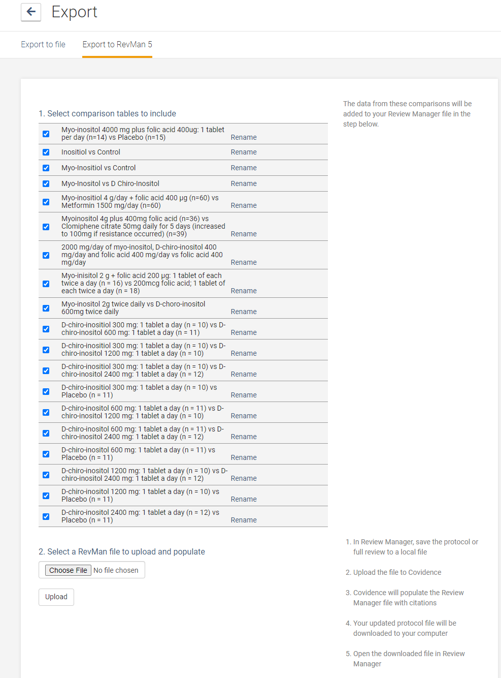
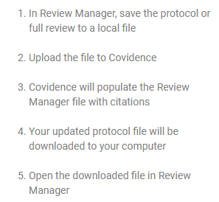

Slide 23
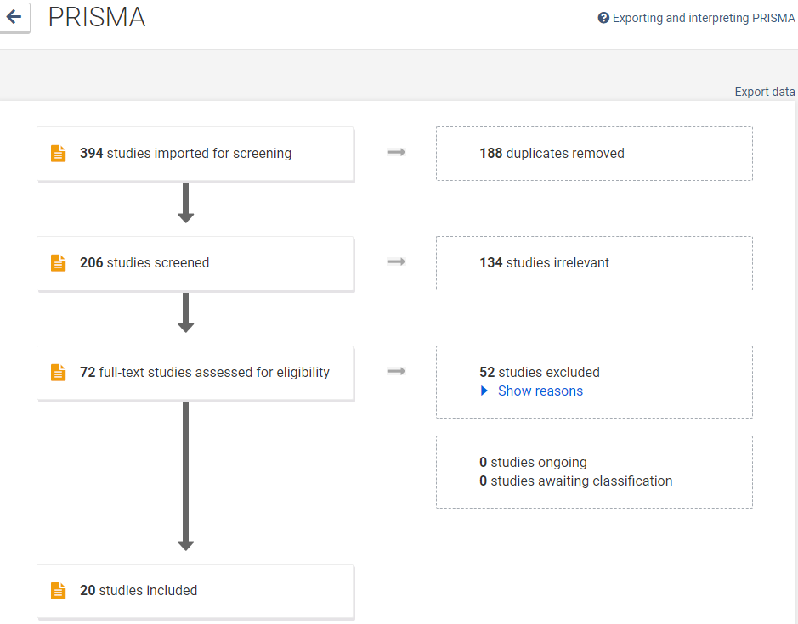
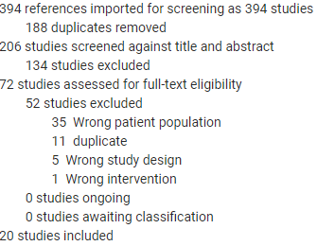
Notes:
Go back to dashboard to Export references as text file to bibliographic management or to excel
see the PRISMA on dashboard and can export the data into REVMAN Dashboard export to file or export the revman watch the youtube videos

Slide 24
Conclusions
Organise your Settings before importing references
Play around with the Demo review
Use extraction 1.0 for Cochrane reviews
For review updates - export to CSV/Excel file not directly to RevMan5
Direct exporting of Covidence files into review updates will overwrite the original review
Data extraction is still a little tricky but will improve
Covidence Knowledge Base (FAQs) and help email
Photo credit Cochrane Community

Slide 25
Support Tools & How to Guides
Covidence Knowledge Base
FAQs
Covidence managers provide 24 - 48-hour support through email
Webinars
Covidence with extraction 1.0
https://training.cochrane.org/resource/covidence-CLL-webinar
Covidence with extraction 2.0
https://www.youtube.com/channel/UCgr_cyJlrKYBjxjyMe2z9mw
Exporting your Covidence review data to RevMan
https://www.youtube.com/watch?v=V01AVTunmBs
Covidence: Accelerate Your Systematic Review, Welch Library, Johns Hopkins University & Medicine https://www.youtube.com/watch?v=mOrdKmiHU9w
Using Covidence for Conducting Systematic Reviews, Welch Library, Johns Hopkins University & Medicine https://www.youtube.com/watch?v=KG4dUZC5AaE

